Slide 1


Organic Pitch Deck
Order Vegetables With Farmer Rather Than Market

Slide 2

Agenda
Fastest delivery of organic vegetables and fruits for your health and that of your loved ones
saving with health

Slide 3

Customer Problem & Our Solution
PROBLEM
SOLUTION
Price Is an important concern for customer purchase daily stuff.
Market is too risky at this time and very expensive.
Market Leave No easy way exists to connect direct farm or become a farm host.
Non-availability of daily necessities at one place.
Order in 5 easy steps.
Vegetables and other daily essential commodities available at less than market price.
Untouched delivery to protect against infection.
Daily necessities available at one place.

Slide 4
Shopkeeper’s Problem
Loss of customers due to infection
Loss of customer contact due to non-contact with any customer
Business does not grow due to the credit of customers
limited area where sales to limited number of people

Slide 5
The Solution
No hassle of borrowing
No limited area
Less risk of infection due to online order
Staying in constant touch with the customer through online orders

Slide 6
Farmer Problem
Daily Transportation
Money

Slide 7
Farmer Solution
We Provide Market To 110+ Farmers Registered With Us On Their Farm
We Are Soon Going To Start The Facility Of Availing 0% Intrest Loan For Our Vendors.

Slide 8
Employment Problem
Un-employment
No Investment

Slide 9
Employment Solution
Our Dost Franchise
Start Business With Zero Investment

Slide 10
Our Investment Revenue
We Start From 10,000 in Aug 2020
Start Earning From Online Order
After few month we start investing from earning
Start Investing In Mini Store & Delivery Point From Oct 2021

Slide 11
The Market
INDIA
WORLD
75B $
Cloth
Cloth
1000B $
1.5B $
Vegetable
Cosmetic
287B $
1.2B $
Cosmetic
Vegetable
14B $
All figures are as per the data given on the internet and the figures given by different websites may be different.
All the figures above are in approx.

Slide 12
Earning Model
B2B Selling
We Start Selling Direct From Farmer/Brand To Street Vendor And Our Retailer
B2C Selling
We Sell Direct Product From Farmer/Brand To Customer

Slide 13
Other Business Model
Selling on Other Website
We also sell our products on the websites of other big brands.
Commission
We take commission of up to 5-10% from all our franchisees
Our Other Brand
Distributorship of our other products (Clothing, Cosmetics)

Slide 14
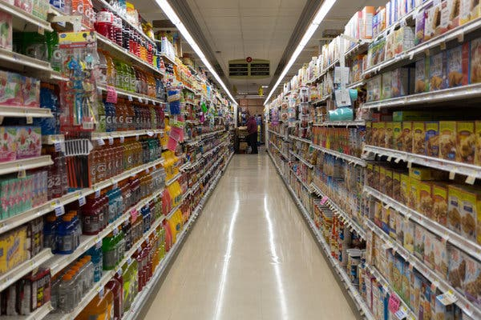
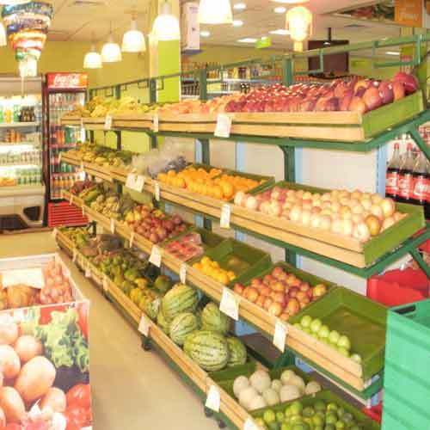
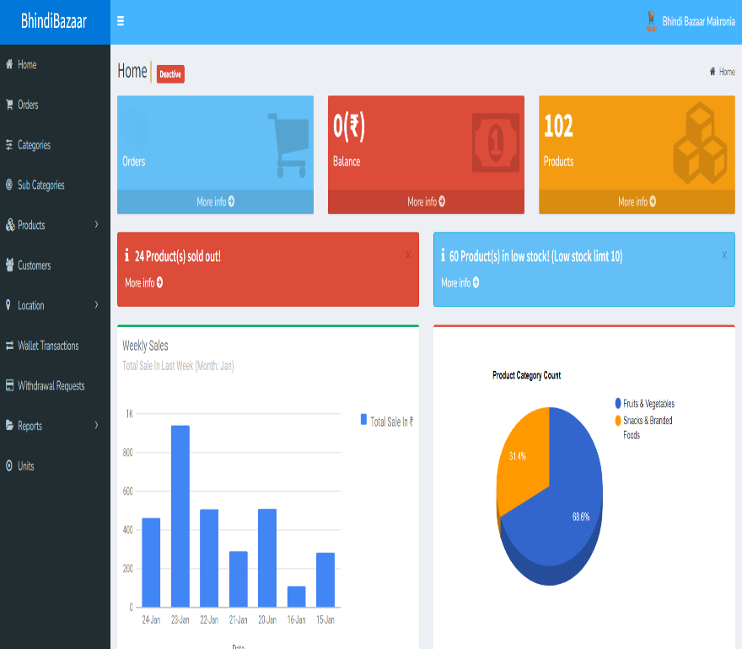
Our Store & Franchise Model
Type Of Franchise
Store
Mini Store
Virtual (Dost)

Slide 15
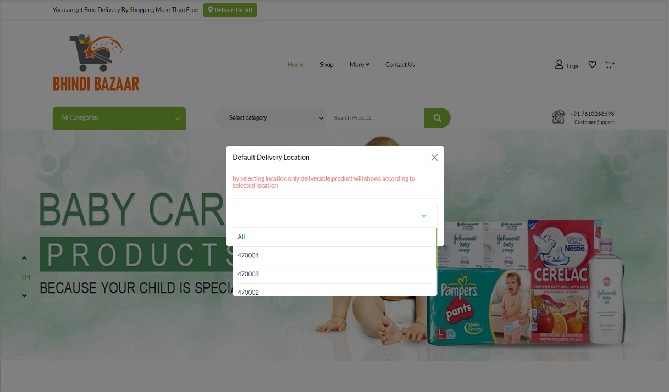
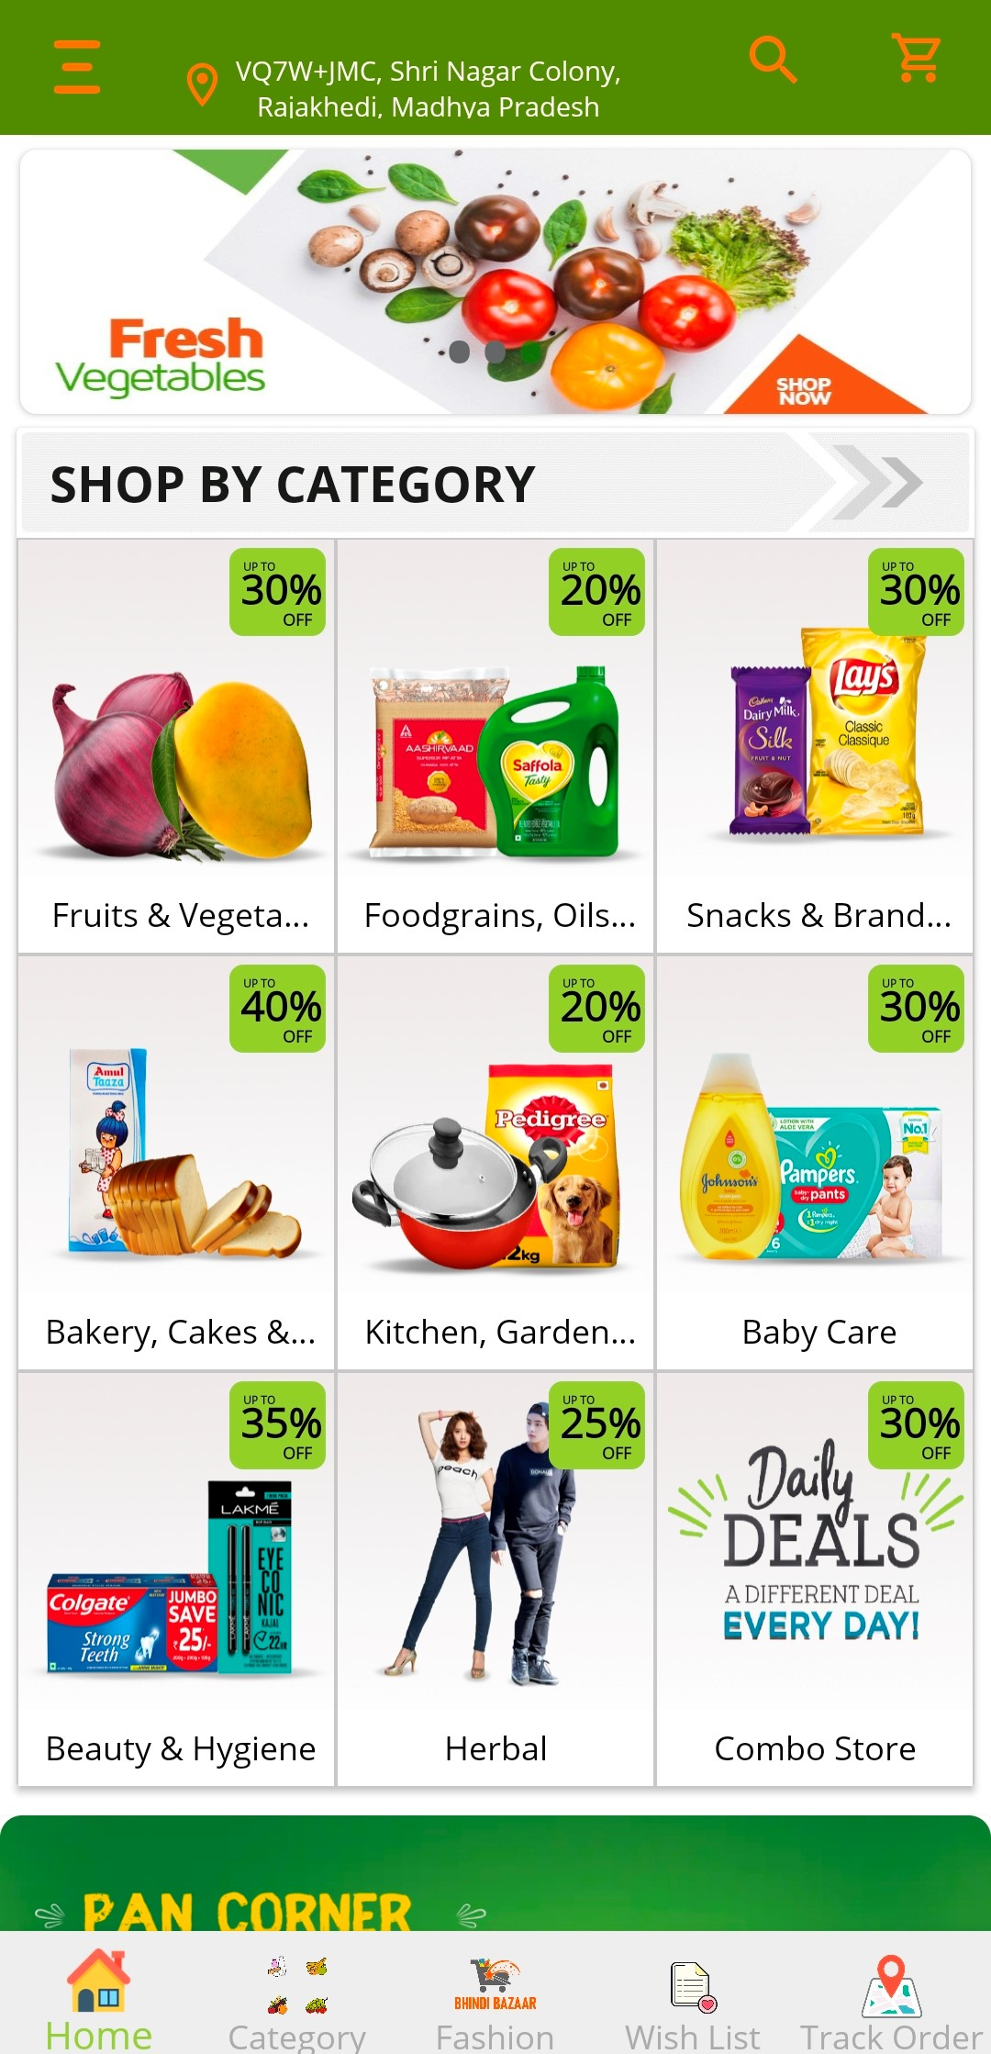
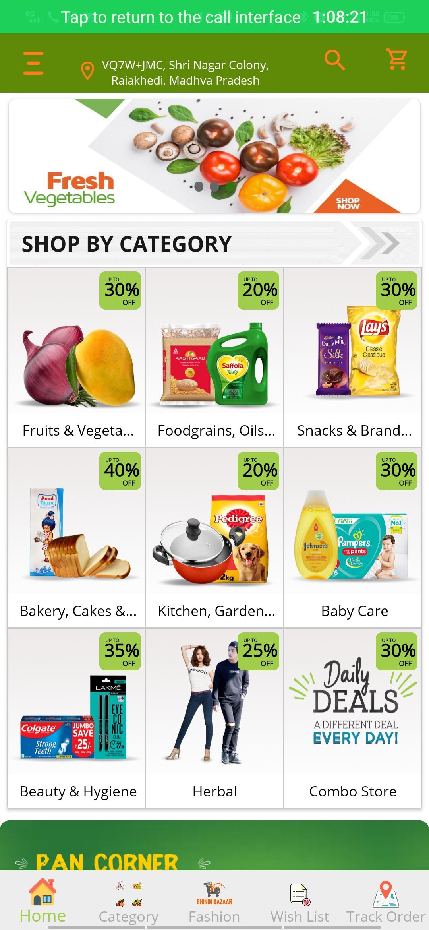
The Web And App Product
Mobile App View.
Our Web View.

Slide 16
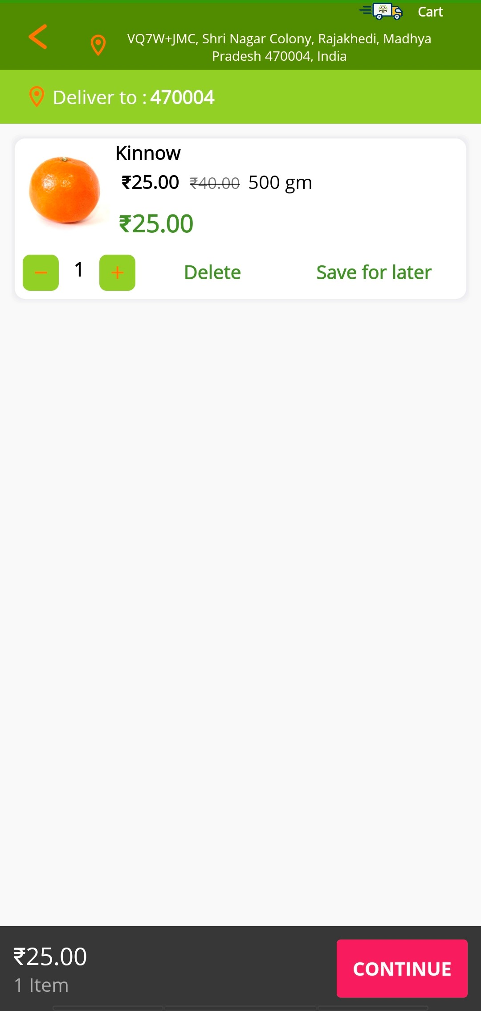
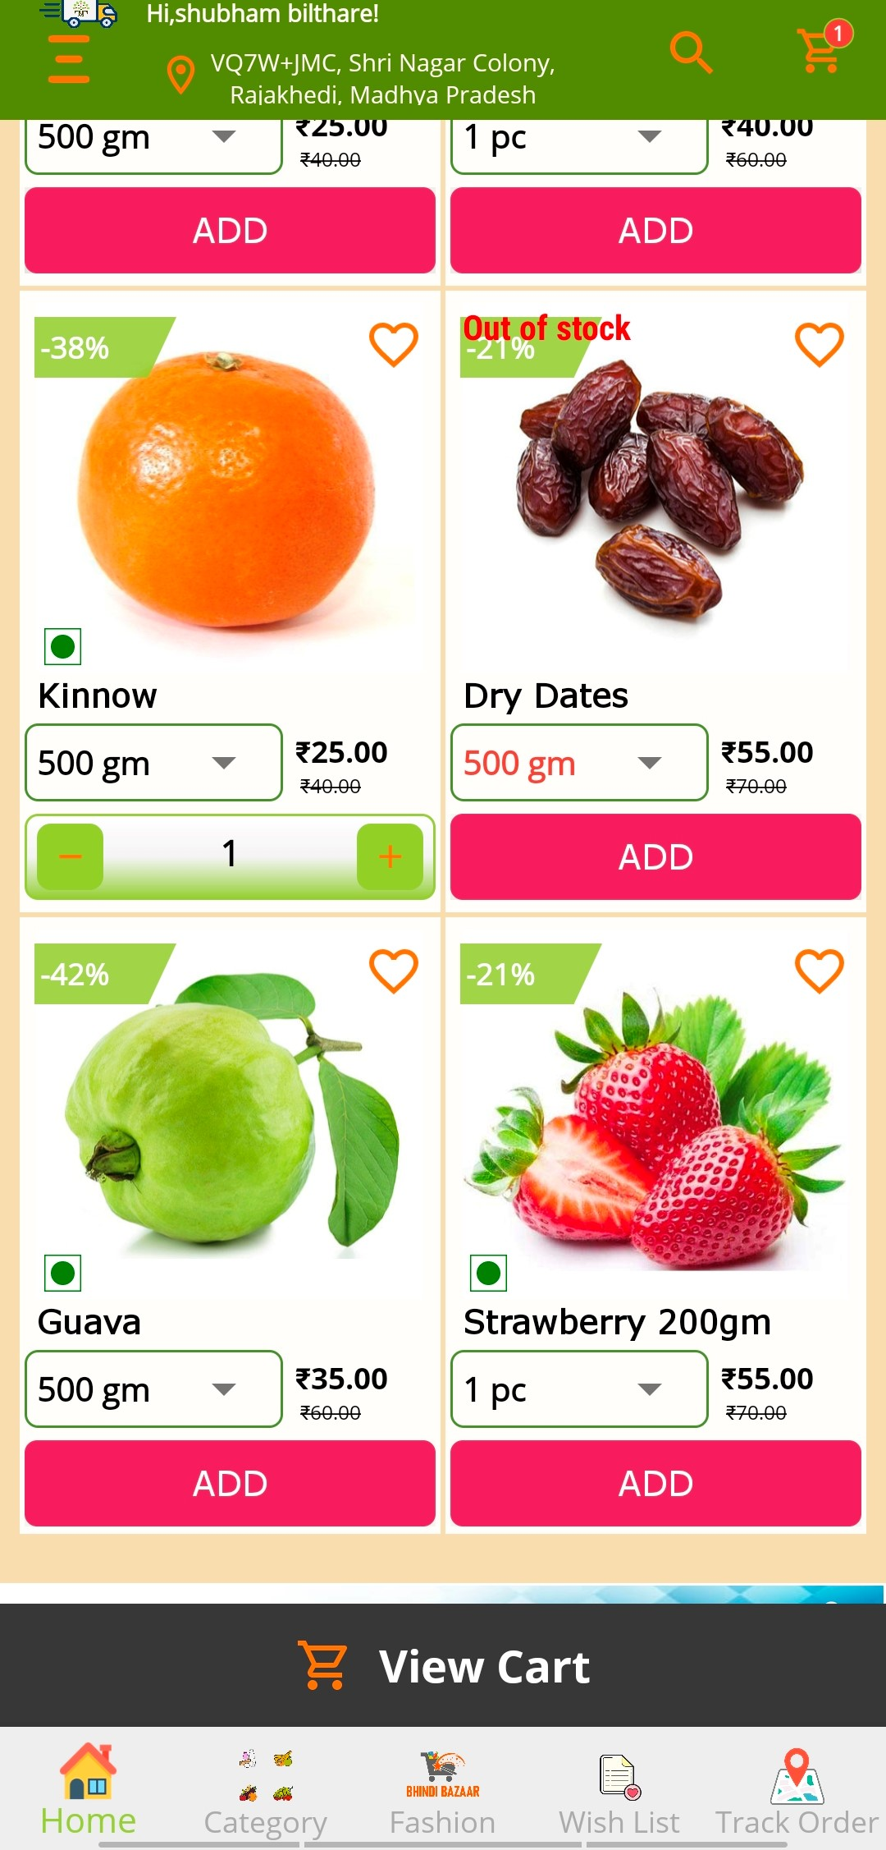
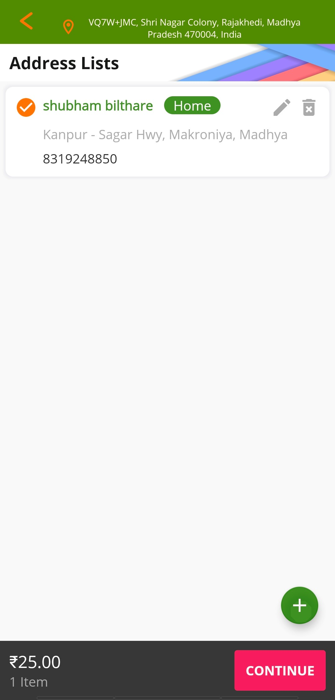
Order Process
Go To Cart
Add Address
Go To Home Page And Add Item In Cart
After Add To cart Go To Cart And Continue
After Cart Go To 3rd Step Set Up Address

Slide 17
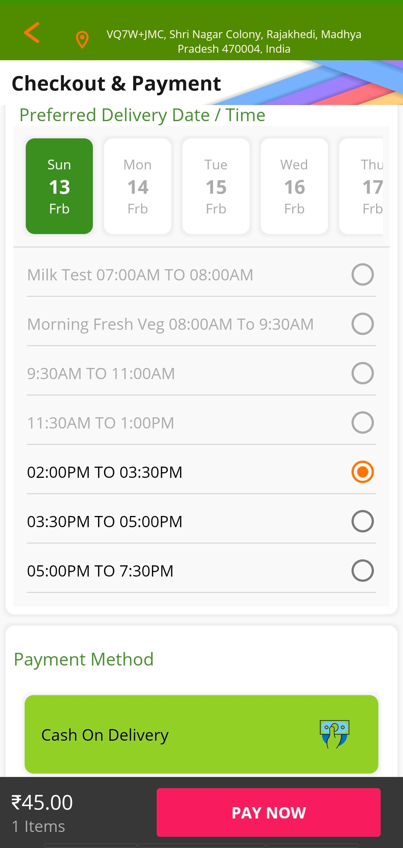
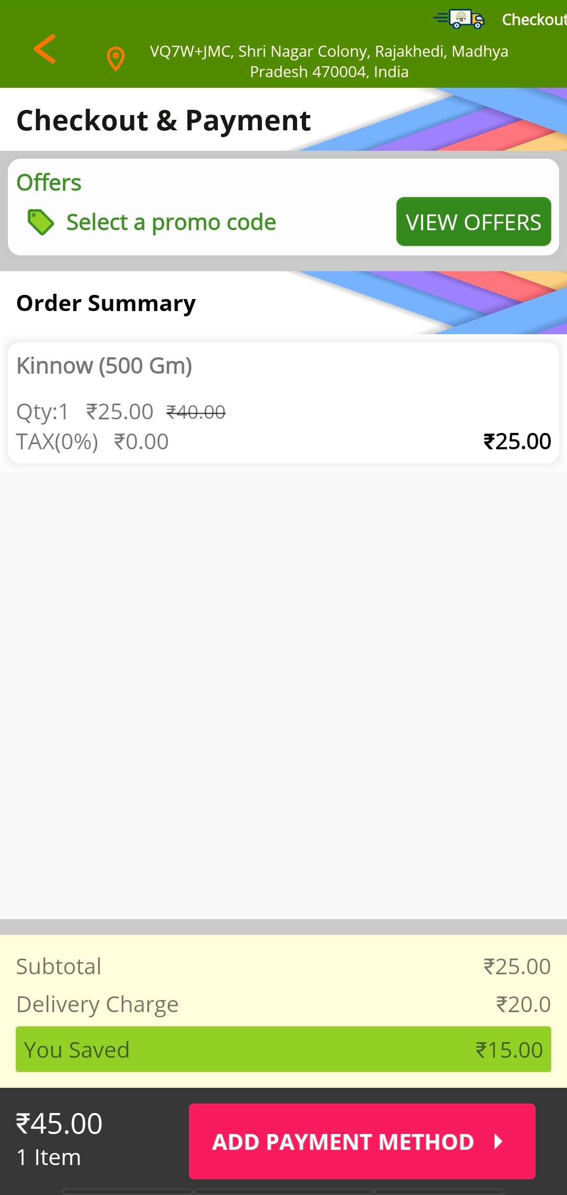
Order Process
Final Step For Process Order
Apply Promo Code
4th Step For Place Order is Apply Promo Code.
5th And Last Option Is Select Delivery Slot And Payment Option

Slide 18
Why Us
Benefits on shopping( Customer )
Cashback of ₹ 5% on the first purchase of at least ₹ 200.
Products booked by customers on the website or mobile app will be delivered to them by their nearest Bhindi Bazaar BP at their home
BP & Company will provide complete support to customers
Credit facility* (Coming Soon) will be provide to loyal customers, this credit facility can be reduced or increased according to their buying trend
If the company discontinues the cash back facility , the qualified customer can redeem his points
Loyalty for up to 6 month
Discount worth 5-40 % on MRP to customer

Slide 19



Our Future Cosmetic Product Range

Slide 20
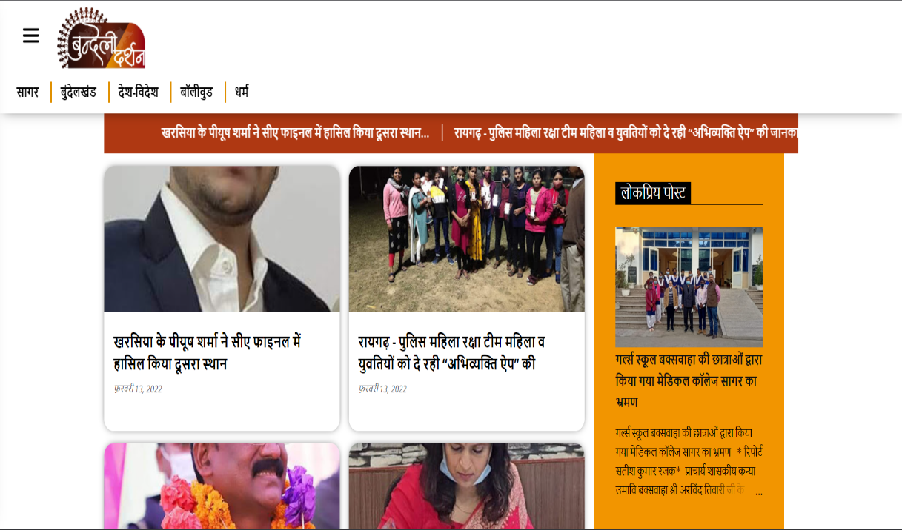


Our Other Future Brand
Complete Clothing Solution
Our Media Partner
Sagar 1St Inter City Pick & Drop Service

Slide 21
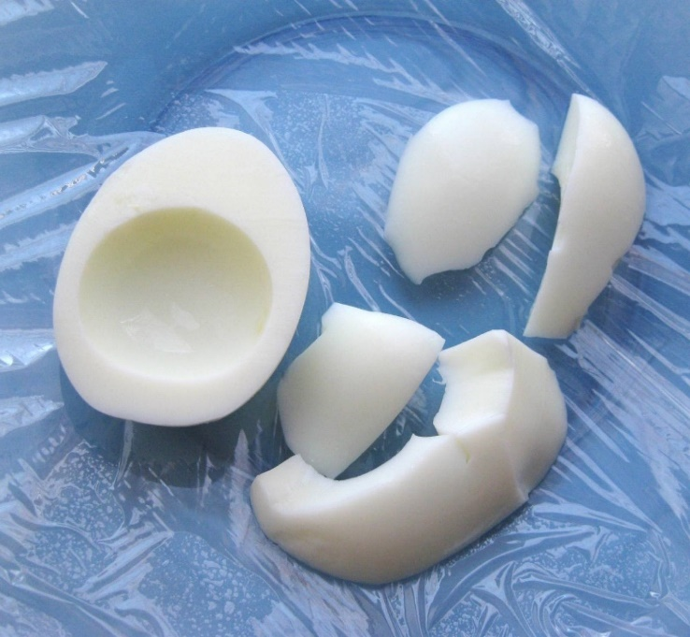
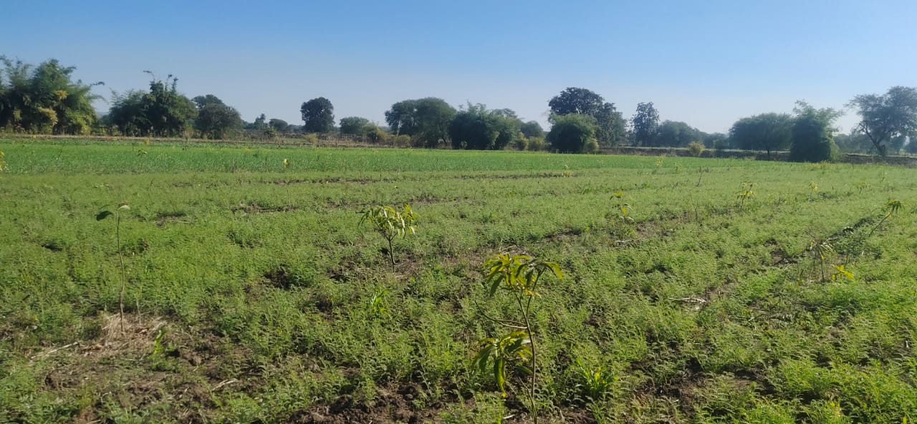
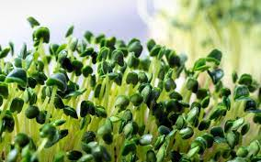
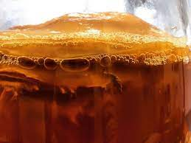
Our R&D
Micro Green & Flour
Egg Made With Flour
Harbel Tea Masala
We Are Testing By Planting Saplings In 5 Acres To Provide Organic Vegetable Plant At Home To The Customer.

Slide 22



Our Associate Brand

Slide 23
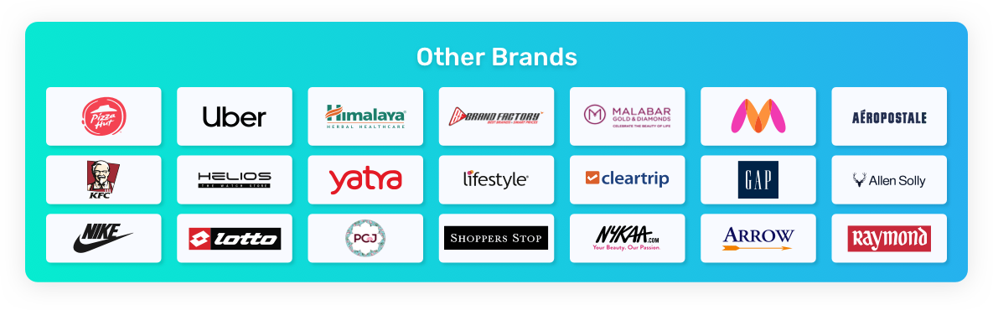
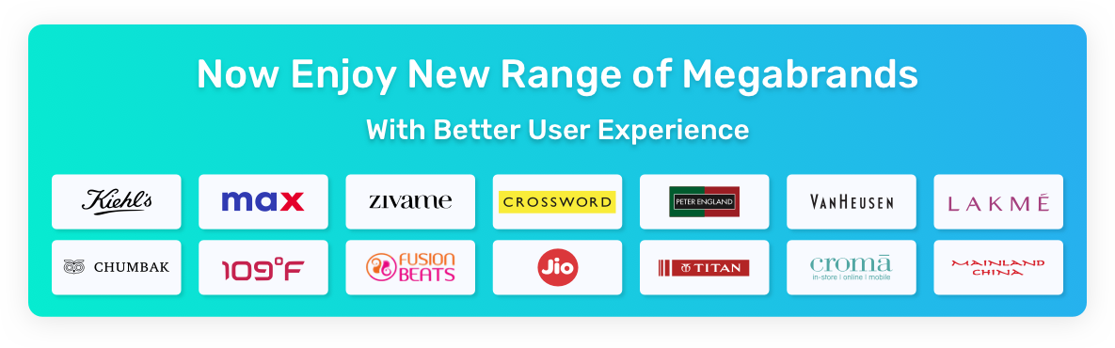

Future Brand Association

Slide 24
Competition
More Convenient
Other Competitor
Other Competitor
More Expensive
Less Expensive
Street Vendor
Indian Market
Less Convenient

Slide 25
Traction
2000+
3.8cr+
110+
Customers
Transaction
Farmer Registered

Slide 26
Current Core Employment Diagrams
Founder
Technical Manager
Refer & Earn
Group Manager
Designing Team
Development Team
Store Team
Franchise

Slide 27
Future Management Plan
Mini Store
Farmer
Store
Cold Store
Virtual Dost
Associate Brand

Slide 28
Future Employment Diagrams
City Admin
Virtual & Mini Store
Store Manager
Management
Delivery Boy
Sales
Delivery
We Setup Minimum 4 Virtual Or Mini Store And 2 Store In A City
Note: According To this Model Minimum In A City 14 Employee.

Slide 29
Milestones
Jan 2022
05
06
We updated our app to Multivendor
Apr & Jul 2022
Oct 2021
We started 3 new store
03
04
We Start Our First Store At Makronia,Sagar
Nov 2021
We opened our second store
01
02
Sep 2021
we launched our app
Aug 2020
We Start Work On Our Idea

Slide 30
Customer Acquisition
SEO
Print Ads
Online
Marketing
Offline
Marketing
Social Media
TV Ads
Email
Call
bhindibazar.com

Slide 31
Financial Table
 | 2020 | 2021 | 2022
Vegetables | 0 | 41,57,742.5 | 89,20,351
Fruit | 0 | 77,57,543.3 | 1,10,15,363.2
Cosmetics | 0 | 3,4000 | 0
Other Products | 100000 | 8,65,000 | 15,00,000
Total | 100000 | 1,28,14,285.80 | 2,14,35,714.20

Slide 32

Our Achievement

Slide 33
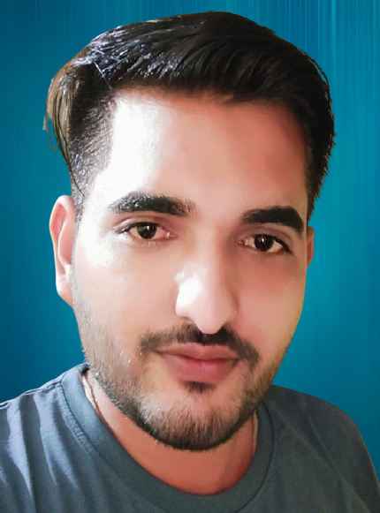
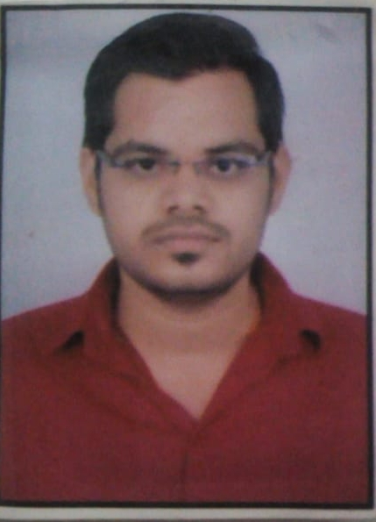
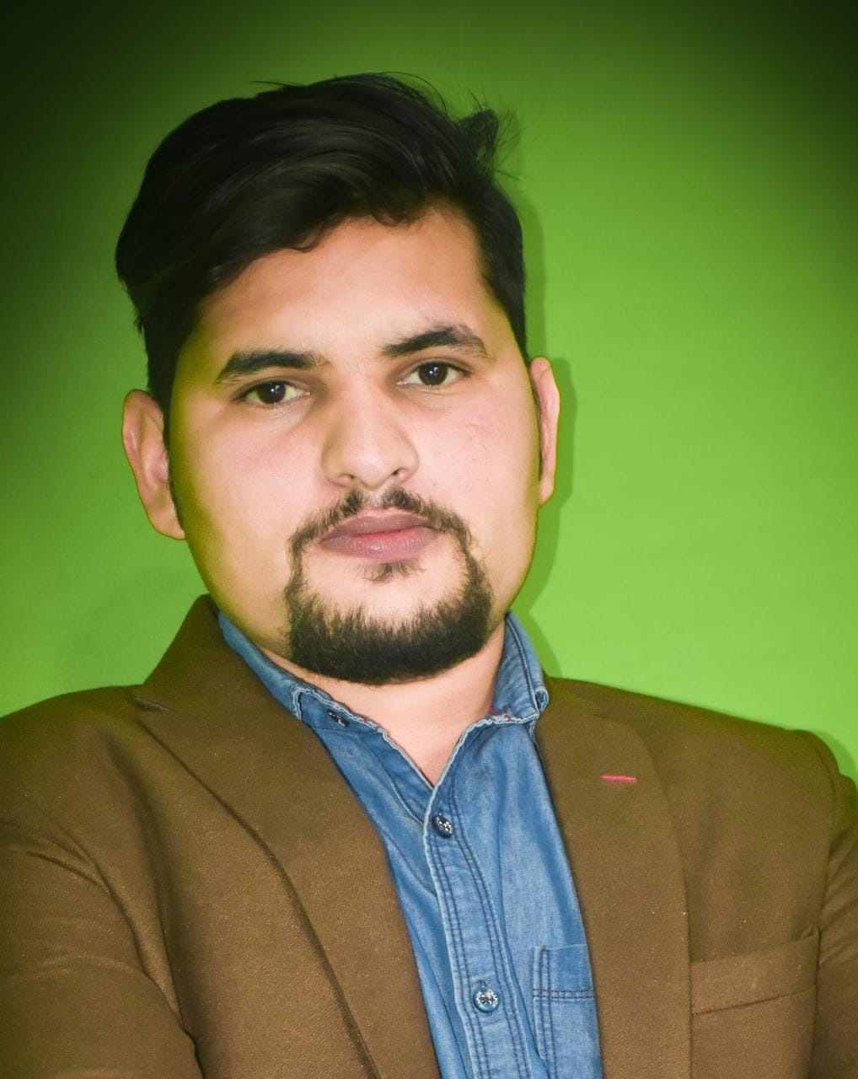
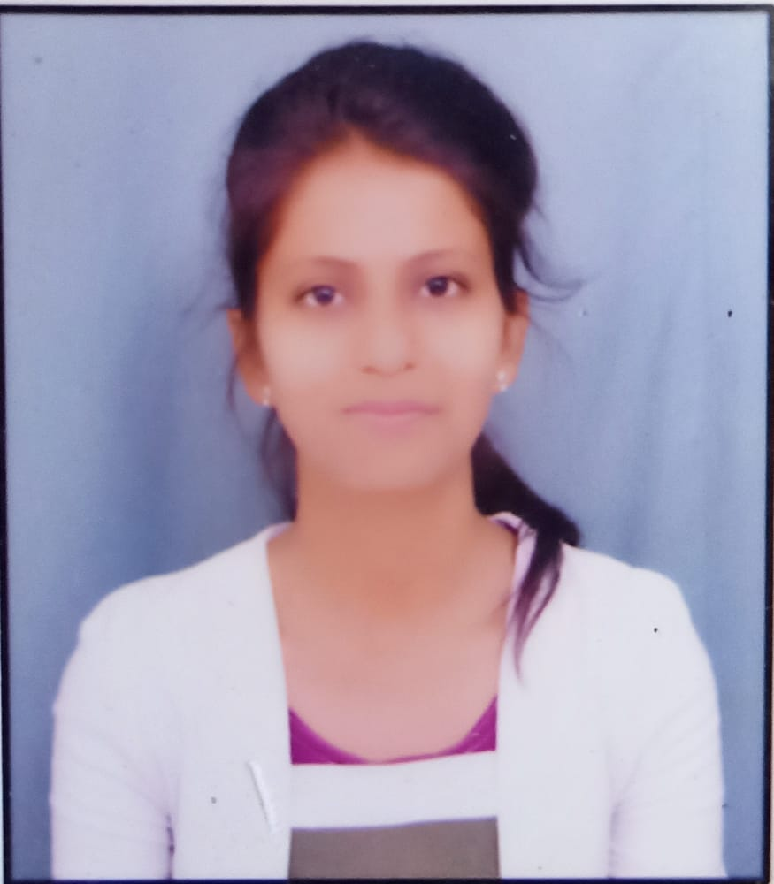
Team
Shubham Bilthare
Arpit Bilthare
Founder & CEO
PHP Web Developer
Co-Founder
Director- Bundeli Media
Sonam Tiwari
Prashant Chowdhary
wingtechwings
Web Developer
wingtechwings
Android Developer

Slide 34
Organically Thank You!
Shubham Bilthare
/Shubhambilthare
Contact Detail:- Mo.- +91 7610268698 Email:-Shubhamsrihmjbp@gmail.com

